Slide 1
EECE 6321 Cyber-Physical Systems Project: Modeling, Design, & Analysis of a Heart + Pacemaker System
Authors: Banks, William &
Darrah, Tim
Notes:
ME

Slide 2
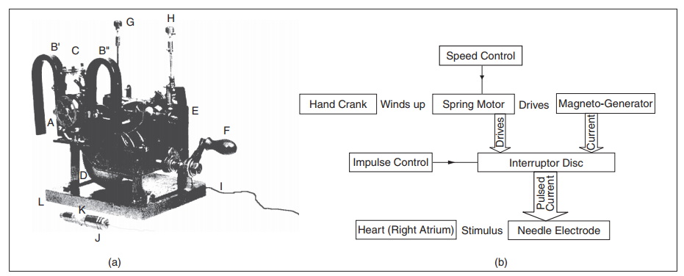
Overview
Introduction
Background
Modeling
Hardware Design
Analysis
Challenges
Demo
(a) The first artificial pacemaker by Hyman. (b) Block diagram of Hyman’s pacemaker. [6]
Notes:
ME
Our presentation is broken up into the following sections. First, we will introduce the topic at hand and provide some background information on our approach. Second, we will discuss our SW model, HW implementation, analysis and a few challenges faced. And third, we will provide a demo of our model.

Slide 3
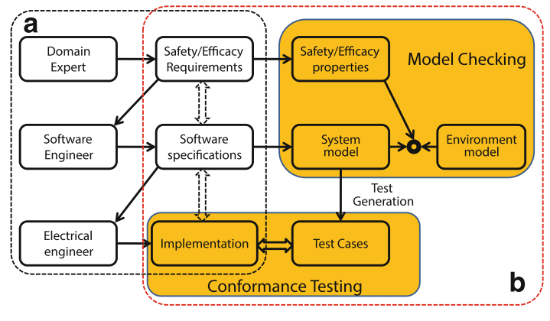
Introduction - Motivation
Medical devices present uniquely challenging design environment
Environment → human physiology difficult to abstract
Categories: open-loop e.g. X-ray machines
Operate under direct supervision
Safety = function of accuracy
Categories: closed-loop medical devices e.g. pacemakers[1]
Depend on own decision making
Combine diagnostic AND therapeutic functionality
~3 million individuals worldwide
10s of thousands of lines of code
‘fail-proof’ over a 5-7 year period
Notes:
ME
Medical devices present a uniquely challenging design environment. Strict safety considerations must be enforced and developing an appropriate test environment is a non-trivial issue. While medical devices cover a wide range of modalities, from adhesive bandages to artificial joins and surgical robots, patient critical devices such as pacemakers represent a sizeable portion. An estimated 3 million individuals worldwide have an implanted pacemaker and that number is increasing by 600,000 annually. Pacemakers represent 10s of thousands of lines of code and must be relied upon to safely and effectively execute autonomous actions within the body over a 5 to 7 -year period [1]. Given this understandable complexity, it is imperative that a rigorous approach to validate both device and treatment be developed.
Medical devices can be categorized into 2 branching categories: open-loop and closed-loop. Open-loop devices such as X-ray machines operate under direction of a supervising physician. For these devices, safety is primarily a function of accuracy. Closed-loop devices operate without direct supervision and therefore must be capable of its own decision making. These types of devices incorporate both diagnostic and therapeutic functionality. For example, the cardiac pacemaker must capture timing information from the heart muscle excitation potential and diagnose any arrhythmia by pacing the heart to a safe level. Because these devices are relied upon to operate mostly autonomously, any malfunction cannot be corrected in a timely manner. Because of this, these types of devices must adhere to the most extensive level of safety regulations.
While other engineering domains possess well defined systems (automotive and aeronautical being chief examples) human physiological models are not well developed. This results in a poor testing environment. For example, every individual part of a car can be modeled for thermal and mechanical strain, electrical interference, etc. Open-loop devices such as the X-ray machine have the benefit of a trained professional physicians with years of education in human physiology to guide treatment and interpret results. In closed-loop systems, devices do not have the benefit of a well-defined physiological model. The pacemaker is limited to a small parameter space (possesses only 2 sensing nodes in fixed places), must be able to ignore erroneous physiological signals and administer therapy within safe levels.
Any medical device must validate design goals in clinical trials with real patients. Because of the extreme safety considerations and need to obtain unambiguous data, clinical trials are very limited in scope. Therefore, clinical trials are an expensive and time-consuming process. Furthermore, because there is no well define physiological model for testing of closed-loop devices, there exists a safety gap between the design phase and the clinical trial phase. Developing complete physiological models for testing closed-loop medical devices is imperative to streamlining the development cycle.

Slide 4
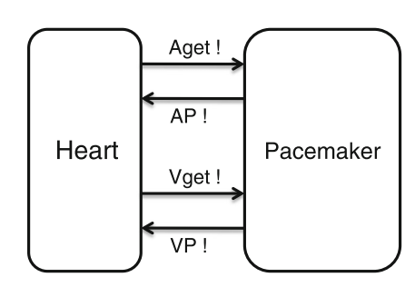
Introduction - Goals
Develop heart environment that creates physiologically accurate ECG signals
Develop pacemaker model that can differentiate between a normal ECG signal and a ‘slow’ ECG signal, and pace a ‘slow’ heart
Notes:
ME
Our goals consist of 2 objectives. The first is to develop a heart model to serve as the Environment. The second is to develop a pacemaker to serve as the device to evaluate.

Slide 5
Outline
Introduction
Background
Modeling
Hardware Design
Analysis
Challenges
Demo
Notes:
ME

Slide 6
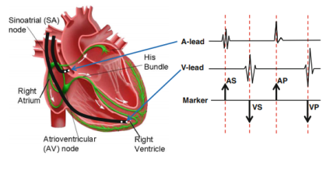
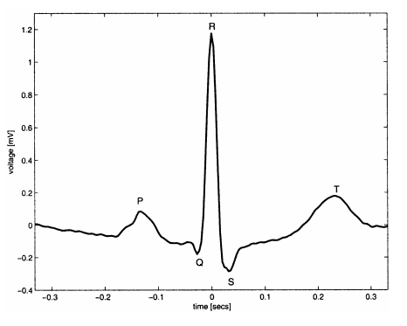
Background
Abstracting the heart as state machines [2,3]
State transitions model timing events
Abstract heart as contracting tissue connect by conductive pathway
Example method described in [4]
State transitions model timing events, PQRST, representing the peaks and troughs of the ECG signal
Input vectors [ecgVals], [timeVals] and [ecgValsSlow] used to mimic PQRST –complex behavior.
Pacemaker:
Mimic timing behavior of heart (PQRST cycle)
Monitor for SLOW ECG signals (slow heart)
IF slow ECG, send pace signal to heart model
Notes:
ME (First half)
We reviewed several papers applying CPS model-based design principles to medical device development, using pacemakers as a test case. This research group is based out of the University of Pennsylvania. There methodlogy is to abstract the physiological heart environment down to a computationaly manageable system. This model describes the heart as tissue connected by a conductive pathway. As one side activates, a signal passes via the pathway and activates the connected tissue. These can be strung together like a string of beads to describe a heart.
TIM (second half)

Slide 7
Outline
Introduction
Background
Modeling
Hardware Design
Analysis
Challenges
Demo
Notes:
TIM

Slide 8
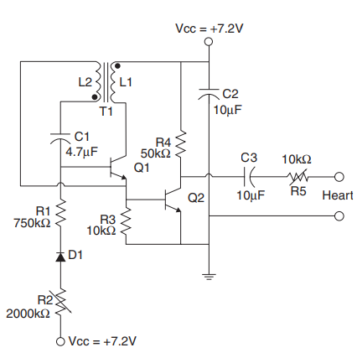
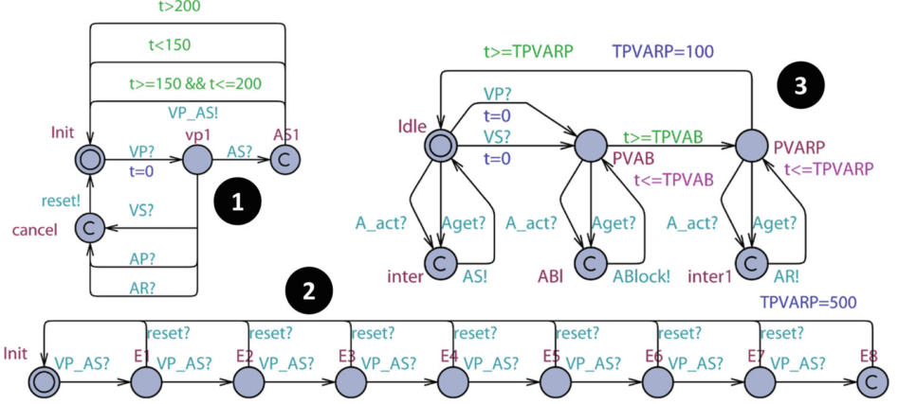
Modeling – Initial Considerations
Analog Circuit Model [6]
Represents the first implantable pacemaker developed by Greatbatch and Chardack (1959)
Consists of a square-pulse oscillator and amplifier
Due to lack of experience in modelling electrical circuits, this option was ultimately not selected
Control Logic Model [2]
Monitors ecg signal state, voltage level, timing, bpm
V&V Done in UPPAAL
Still lack experience in modelling, but felt more confident modelling the logic
Notes:
TIM

Slide 9
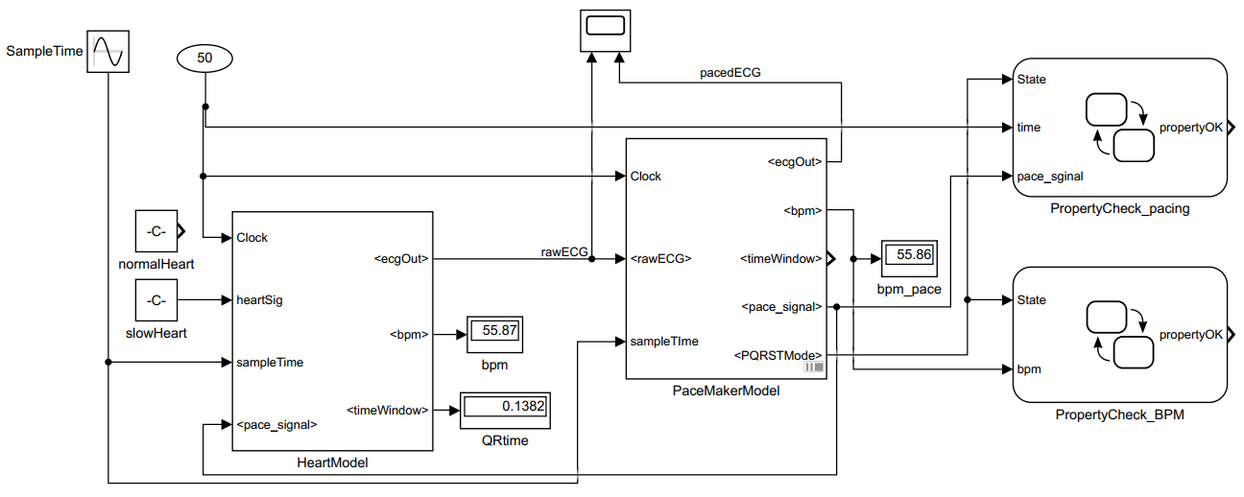
Modeling – HeartPaceModel
normalHeart & slowHeart are array of numbers
HeartModel generates ECG signal based on array input by modeling heart as series of timing events (states)
HeartModel ECG output serves as PaceMakerModel input
If timing between events (states) exceeds limit, pace_signal = TRUE
Notes:
ME
Here we can see the top-level Simulink model of our system. The system has 1 block to containing the heart logic and 1 block containing the pace logic. The block, ‘normalHeart,’ uses the appropriate input ecgVals and timeVals to create the right PQRST –complex. The block, ‘slowHeart‘, uses ecgValsSlow to create a ‘unhealthy’ heart. The HeartModel block takes in the array of inputs and a SampeTime and generates the correct ECG signal. This signal output becomes the rawECG signal input for the PaceMakerModel. The internal logic of the Pace model is identical to the Heart model except the Pace model has an added function to look for slow timing events and to output a pace signal to ‘speed’ the heart ECG along. The blocks to the right, PropertyCheck_pacing and ProperyCheck_BPM are safety and liveness checks. These take in outputs of the Pace Model to ensure that it is functioning as designed.

Slide 10
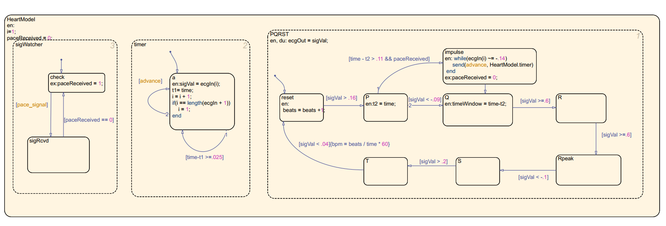
Modeling - HeartModel
Notes:
TIM

Slide 11
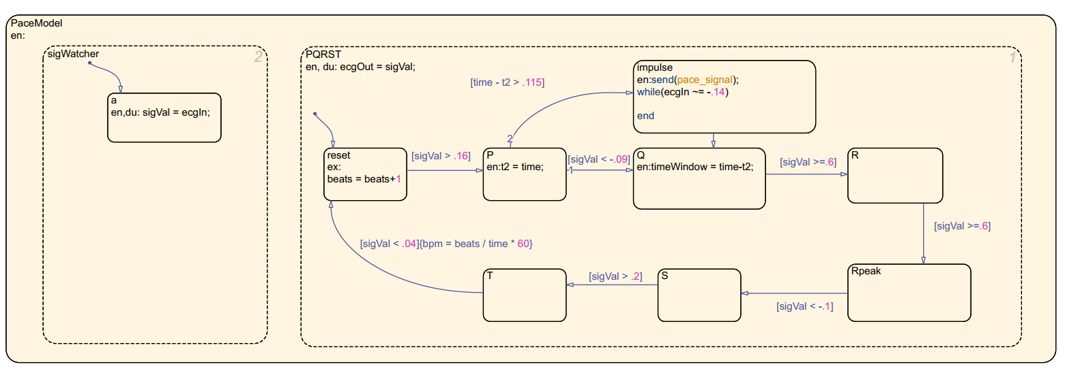
Modeling - PaceModel
Notes:
TIM

Slide 12
Outline
Introduction
Background
Modeling
Hardware Design
Analysis
Challenges
Demo
Notes:
TIM

Slide 13
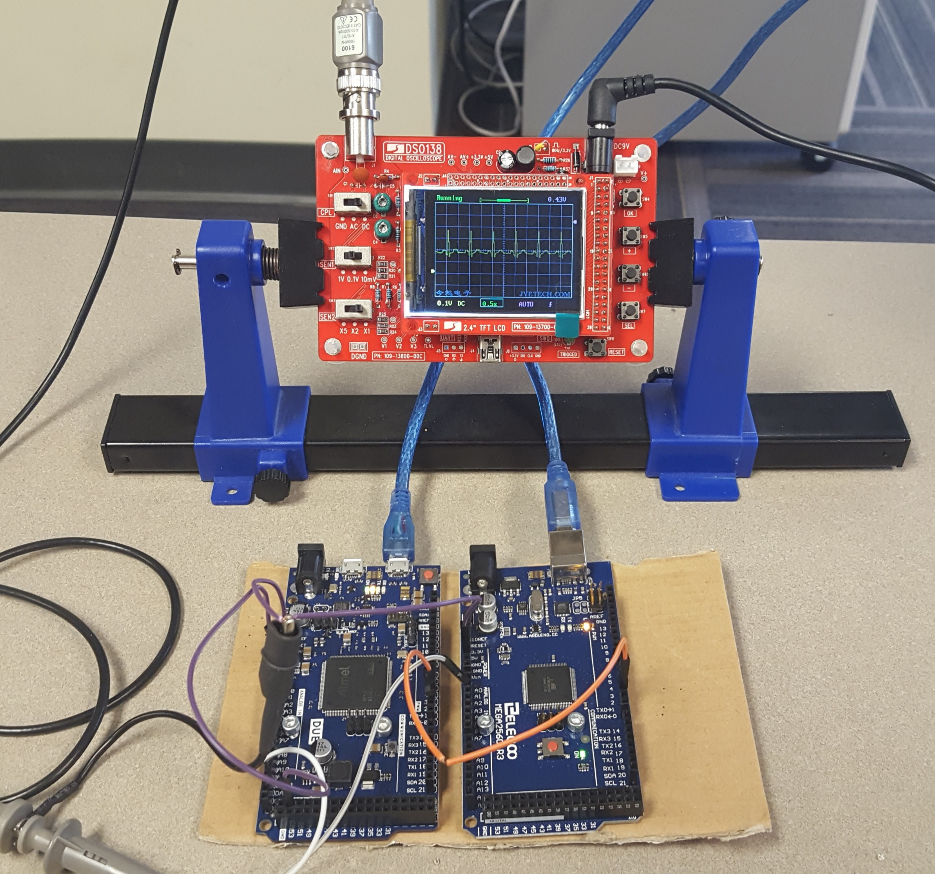
Hardware Design
The Heart
Arduino Due
32bit ARM Cortex M3
3.3v I/O
12bit DAC
The PaceMaker
Arduino Mega
8bit AVR ATmega 2560
5v I/0
10bit ADC
Notes:
We chose the Arduino platform because its programming environment is ubiquitous across different models, and, the Due and Mega meet our requirements. The Due is unique among any of the Arduino boards in that it contains a 32bit ARM Microprocessor rather than an 8bit AVR based microcontroller. The Due is suited for the heart due to the necessity to replicate an ecg signal, which a 12bid DAC can do. The mega controls the pace maker logic, and has a 10 bit ADC. We could have used the Due for both, but could not have used two Megas. The mega is a little more than half the price of the due, so we went with one of each.

Slide 14
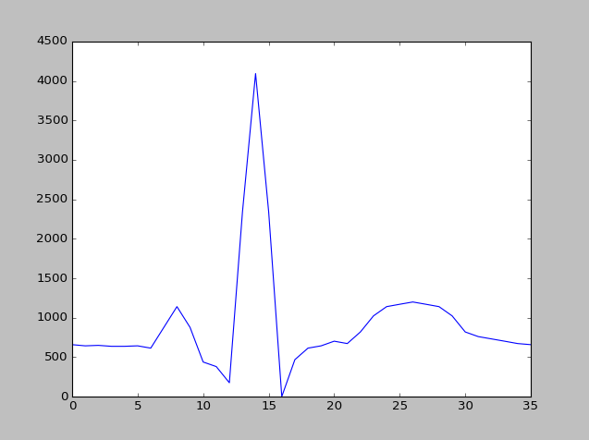
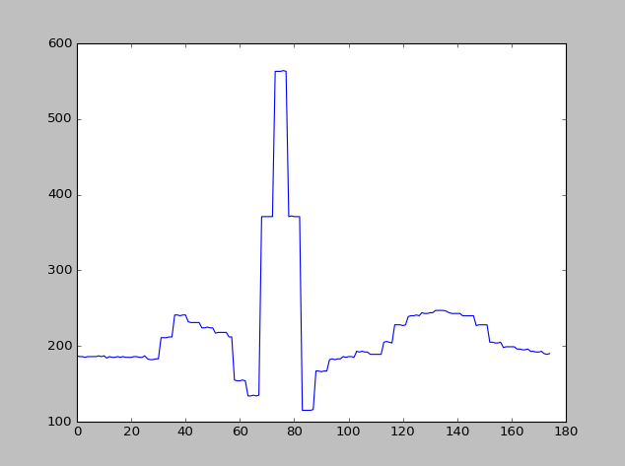
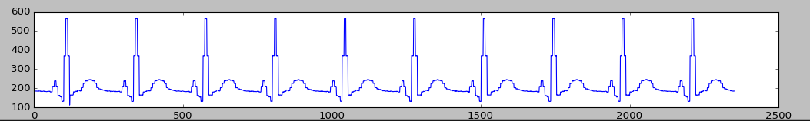
Hardware Design
12bit DAC @ 3.3v I/O ref
10bit ADC @ 5v I/O ref
Rp/4
Signal value
Signal value
R/3
T/6
P/1
Q/2
S/5
Sample #
Sample #
Notes:
Here is a closer look at the signal generated from the Heart, and how that signal is processed by the pacemaker, and down here is a sample trace of the ecg signal. Notice the difference in the Y scale. 12 bits gives 4096 discrete values, and 10 bits gives 1024, why is the peak ecg value on the heart, which is 4095, not registering as 1024 on the pace maker? Which signal is the one on the right depicting? Now lets take a closer look at the details of the design

Slide 15
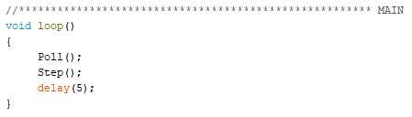
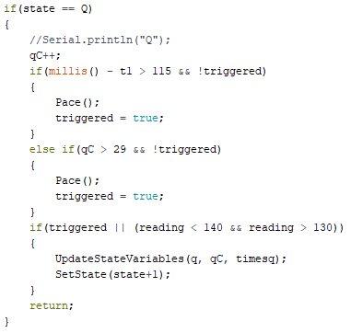
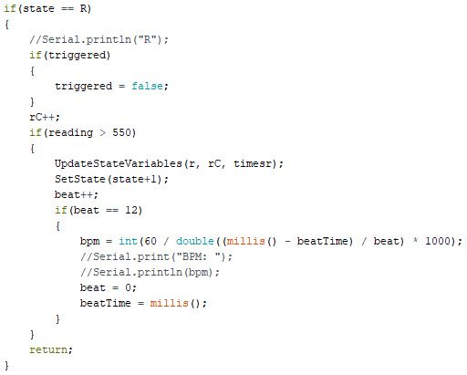
Hardware Design
Functions:
Poll
Step
SetState
UpdateStateVariables
Pace
Step function snippet
Code at https://github.com/darrahts/PaceMaker
Notes:
Main is very simple , makes tracking the logic flow intuitive. Can anyone determine what the polling frequency is? After some initialization the pace maker first polls the ecg signal in pin then steps the state machine where the state is an enumerated variable.
Since we are timing the transition from Q we monitor this with redundancy. Just like we saw in last class, coincidentally, only one of these will ever execute in a single step.
First, real value time in milli seconds, and secondly, as a counter for the number of times a state has remained Consecutively at every poll.
Either way, the machine eventually updates (temporal logic) the state variables, sets the state, and returns to the main where it will delay for 5 milli seconds. In R, we calculate the bpm at the 12th beat (enter into Rp). This number was chosen arbitrarily, but we didn’t want something too short as to give false readings and we didn’t want something to cause a long wait for the user.

Slide 16
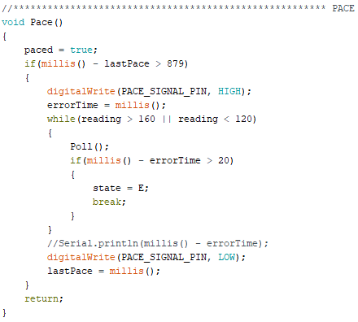
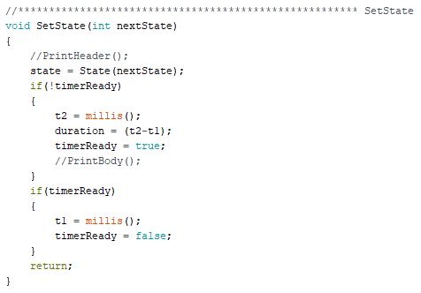
Hardware Design
Code at https://github.com/darrahts/PaceMaker
Notes:
Here are two other key functions of the pacemaker. Can anyone guess why this is 879? One of our requirements is that the pace maker does not pace the heart over 68 bpm, so this translates to a minimum inter-beat-time of 880 ms. Then, once it paces the heart it waits until it receives the proper response before returning.
The set state function manages the state transition and in-state-duration monitoring. When the state transitions, the timer isn’t ready (because its already currently in use), then duration is calculated, and the timer becomes ready. Immediately after that, in the same step, the timer is restarted.

Slide 17
Outline
Introduction
Background
Modeling
Hardware Design
Analysis
Challenges
Demo
Notes:
TIM

Slide 18
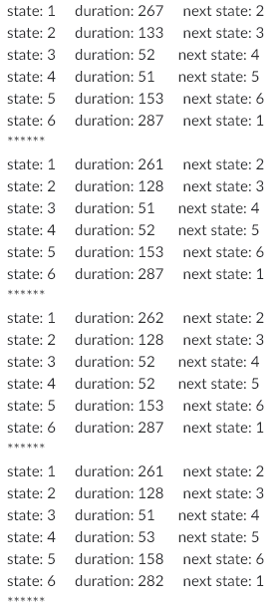
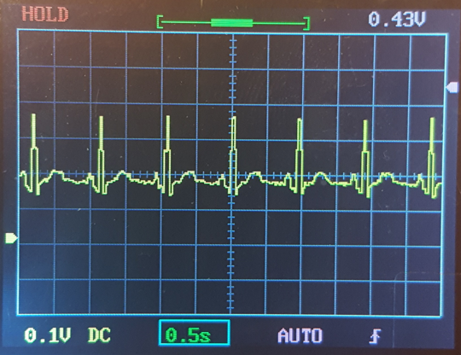
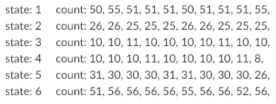
Analysis – Hardware Implementation Healthy Heart
B
D
C
64
A
E
Notes:
Here is our healthy heart, beating at 64 beats per minute. The table on the left is a subset of the running duration totals for the total time the pacemaker is in any given state. We can see here, that the machine remains in state 2, corresponding to Q, for about 128ms. The table on the right is a running count of the number of times the pace maker stayed in a given state per step. One key thing to take away from this is that there is always some level of randomness that is nearly impossible to eliminate, even on single threaded microcontrollers.

Slide 19
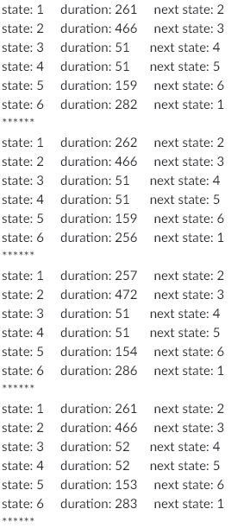
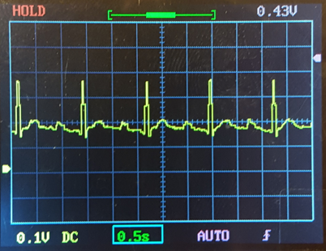
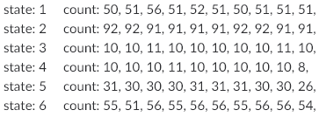
Analysis – Hardware Implementation
Slow Heart
D
B
C
47
A
Notes:
Here is our “slow” heart. Notice its duration in state q is substantially longer than a normal heart signal, and this is also corroborated by the number of steps it was in state Q before transitioning. Before it was 25 -26, now its 91-92.

Slide 20
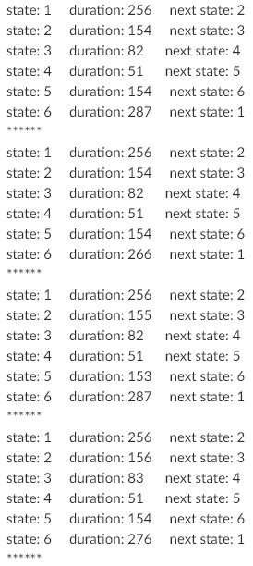
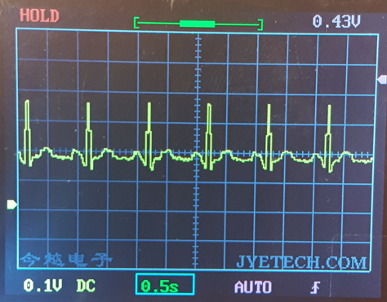
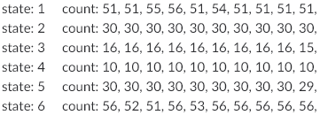
Analysis – Hardware Implementation Paced Heart
D
B
C
59
A
Notes:
Finally we have our paced heart. The first thing to notice is we have brought this heart from 47bpm to 59bpm, which is within tolerance for our 60bpm goal, and under our max threshold of 68bpm.

Slide 21
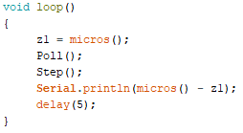
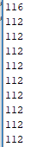
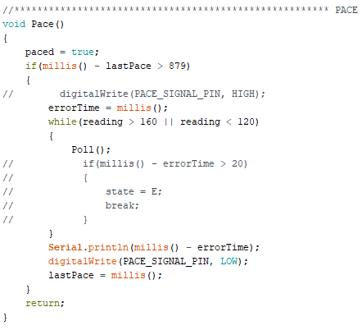
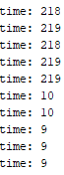
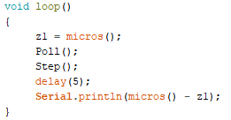
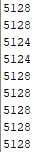
Analysis – Hardware Performance
Execution time
Pace time
Without pace
Micros
Millis
With pace
Notes:
Here are some interesting timing results. The pacemaker takes 112 microseconds to complete one operational cycle in pacing mode, so you would think that you wouldn’t need to time it with a 5 millisecond delay because you can just add it right? Surprisingly its not the case. These types of discrepancies are what CPS problems are all about and dealing with them is not trivial. The 14 phantom microseconds might not seem like a big deal, but in safety critical systems it can mean the difference between life and death.
On the right is some timing analysis on the pace function. First is the amount of time the machine is polling the signal until the state change is detected, without pacing the heart. The bottom times are given when we are pacing the heart. Just as before we can clearly see the pace functionality working properly.

Slide 22
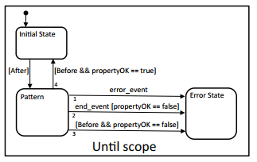
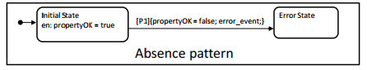
Analysis – Approach
Looked at UPPAAL and Simulink Design Verifier
Powerful tools < time constraints
Settled on technique followed as described in [5]
Stateflow automata are used to monitor 1 liveness and 1 safety property
Combination of Pattern and Scope automata allow accurate monitoring of property
Only consider PaceModel outputs and system time
Notes:
ME
We evaluated several methods to perfrom the Verification & Validation portion of our project before settling on our actual approach. First, literature suggested that the tool UPPAL is well suited for time-varying systems. However, a running theme of our project is that time constraints win out over good ideas. Because UPPAAL presented a totally new toolset to learn, we did not feel confident that we could had enough time to learn and implement it effectively. Because we wanted to be judicious with time, we looked into Simulink V&V options which tipped us off to Simulink Design Verifier. This is an incredibly robust toolsuite that allows complete tracking of requirements, automatic report generation, formal verification and other functions to V&V your system. Again, we didn’t feel we would have enough time to learn how to implement this method.
Professor Karsai clued us into our chosen method via the paper referenced. This paper outlines how simple state automata can be used to check for defined properties. These can be implanted into Simulink as Stateflow models. The paper describes a simple paradigm to construct these models: scopes and patterns. Scopes describes when a particular property should hold during execution, and a pattern defines what conditions must be satisfied in that time. An example of a scope and pattern is shown here.

Slide 23
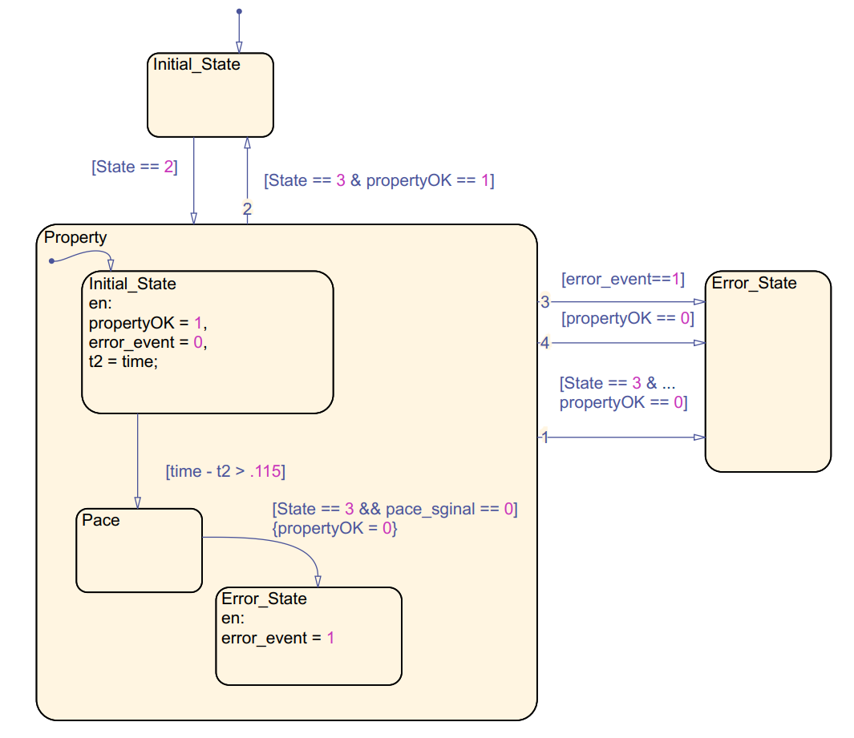
Analysis – Liveness Property
Property: Will the PaceModel always fire a pace_signal if time spent in state P exceeds 0.115 seconds?
Enter Initial_State
Check if PaceModel is in state P (State == 2), if TRUE then enter Pattern and wait in Intial_State; start tracking time in P (t2 = time)
If (time – t2 > .115), checker expects PaceModel to have entered Impulse
If PaceModel is in State Q (Sate == 3) and pace_signal == 0 is TRUE, no pacing event occurred and PropertyOK is set to FALSE
If PaceModel is in State Q (Sate == 3) and pace_signal == 0 is FALSE, pacing event occurred and PropertyOK is unchanged
Notes:
ME
We define a particular liveness property as follows: PaceModel always fires a pace_signal if time spent in state P exceeds 0.115 seconds.
First, the checker is in the Initial_State and is waiting for the pace_model to enter state P. Once [State == 2] is true, it transitions into the property and waits in Initial_State. It starts keeping track of time spent in P by setting t2 = time. While time is ticking on, it waits for time-t2 >.115 and transitions into Pace. This transitions reflects the expectation that pace_model has also entered the pace state. The expectation is that the pace_model will fire a pace_signal and then enter State Q. This is monitored by the transition [State==3 & pace_signal == 0]. If both conditions are true, the property has not be held and PropertyOK is now FALSE.

Slide 24
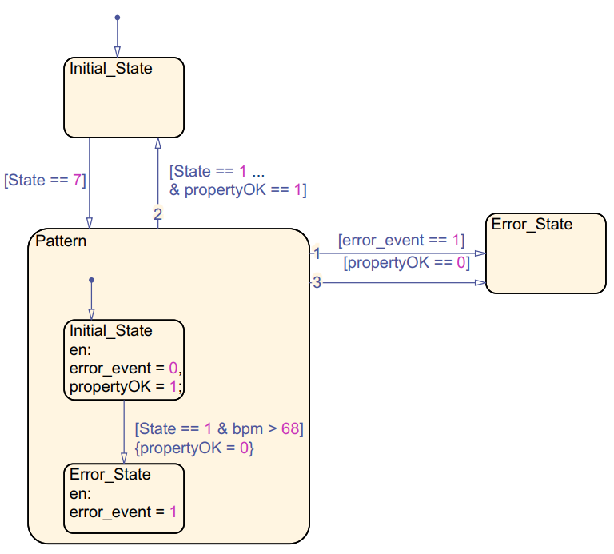
Analysis – Safety Property
Property: Will PaceModel never pace the heart above 69 BPM?
Enter Initial_State
Check if PaceModel is in state T (State == 7), if TRUE then enter Pattern and wait in Intial_State
propertyOK must always be TRUE for condition to be satisfied
When transition from State T to Reset, State == 1 resolves TRUE.
If bpm > 69 is TRUE, enter Error_State and set PropertyOk = FALSE
If bpm >69 is FALSE, stay in Initial_State
Notes:
ME
Heartbeat is calculated at the end of the cycle (beat indexes in state reset and BPM is calculated during transition from state T to reset.
This monitor functions in a very similar way to the pace_signal monitor. It waits in an Initial_State and checks input State values. If it detects that the pace_model is in State T, then the guard [State==7] is TRUE and it transitions into the Pattern where it waits in an Initial_State. It monitors the BPM calculating and if it exceeds 68 BPM, then flips PropertyOK to FALSE and the monitor transitions out of Pattern and into Error_State.

Slide 25
Outline
Introduction
Background
Modeling
Hardware Design
Analysis
Challenges
Demo
Notes:
ME

Slide 26
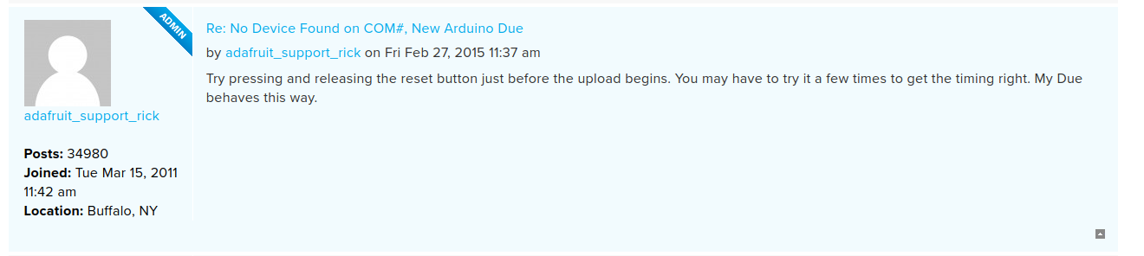
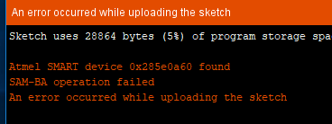
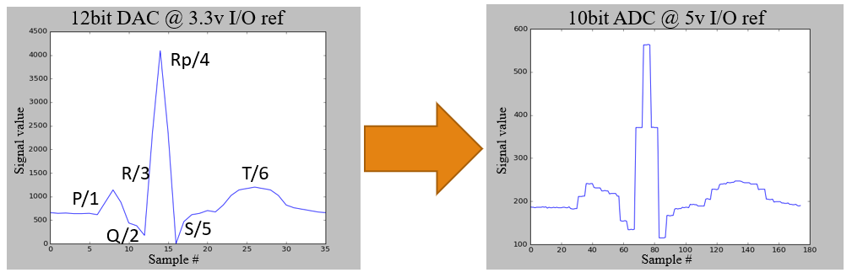
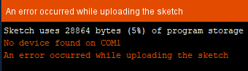
Challenges
Dealing with new hardware
Dealing with varying I/O scales
Direct coding vs code deployment
Notes:
We faced several challenges with this project, which ultimately push us to the next level by the pain and suffering of figuring them out. Especially when accepted answers on popular forums from the admins themselves include “try pressing the reset button before you upload, try it a few times to figure out the timing”. Its 2018, and these types of “solutions” are still inescapable. I remember back in the army working on the mike model Blackhawk, a fly-by-wire helicopter with all digital instrumentation. Sometimes we would do what we called a mike model reset when we couldn’t figure out a persistent error that troubleshooting results made no sense for. Most of the time, the error went away. Again, safety critical system, life and death impact, and we have to reset it to make an error go away? Anyways.
Also a challenge was how to deal with all the different scales. Yes, it boils down to simple mapping conversions, but getting to the boiled down part was a challenge. Not only was the resolution of the converters different, but their I/O reference voltages were different as well. Since we haven’t dealt with this before, we had to work through it very carefully.
Finally, direct coding versus code deployment. We spent a lot of time trying to figure out how to get our model deployed, and were able to deploy very simple led blinking examples, but when it came to dealing with time, how do we code that up? Arduino uses a built in function called millis(), and we couldn’t add custom code to Simulink that would make this work. So we decided to code the hardware from scratch, which, at first, was a huge leap. How to go from a graphical based model to textual based code? Obviously we did it, but not without some sweat and stress.

Slide 27
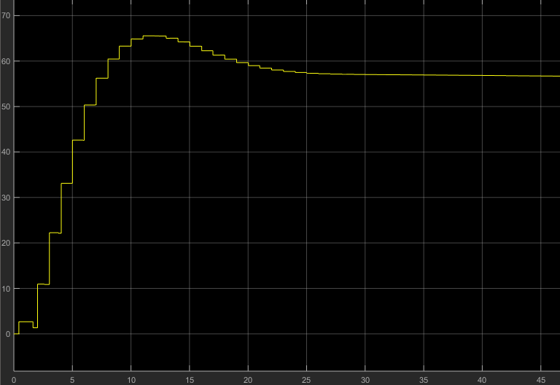
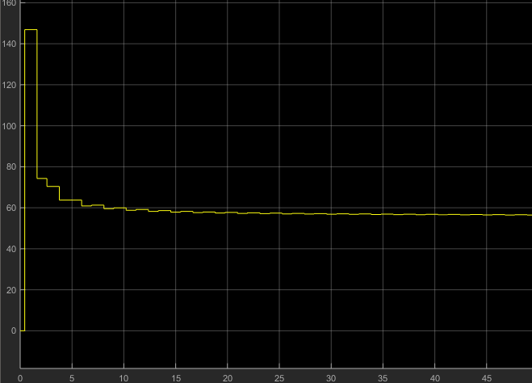
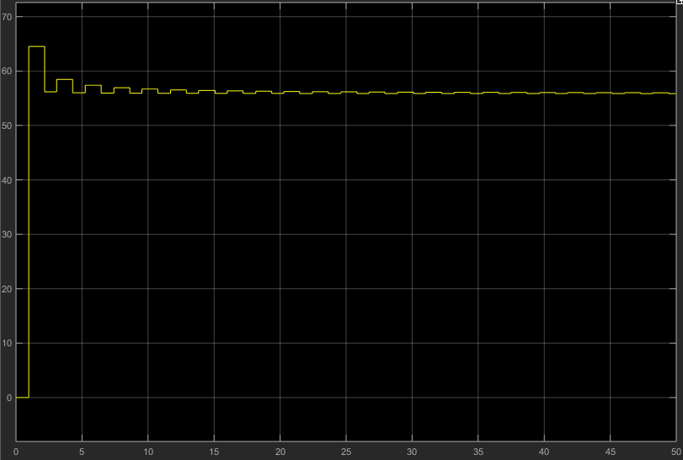
Challenges
BPM calculation
Spike!
Low Pass?
Change timing of calculation!
Notes:
ME
Not all challenges needed to be particulary complicated but nevertheless resulted in disastrous effects. While implementing the BPM checker, we found that the BPM calculating function intitially spikes up to ~140 BPM before quickly reaching a steady state at the designed rate. The BPM calculator is a simple function: BPM = beats/time * 60. However, at time less than 1, the quotient inflated before resuming the normal behavior. The function is correct and the function inputs are correct, so how to handle this? A low pass filter could be applied to smooth out the high frequency spike which can be see in the middle figure but this felt unsatisfactory and required additional components to fix. After much trial and error it occurred to us to simple move the execution fo the BPM calculation to the end of the heart and pace PQRST cycle. Instead of calculating the BPM during Rpeak, we calculate BPM during the transition from T to Reset. This allows time to increment enough to not cause the initial spike. This can be see in the right figure on the right. A small spike persists but it is within the safety window.

Slide 28
Outline
Introduction
Background
Modeling
Hardware Design
Analysis
Challenges
Demo

Slide 29
References
[1] Jiang, Z., and Mangharam, R. High-confdence medical device software development. Foundations and Trends in Electronic Design Automation 9 (2015), 309–391.
[2] Jiang, Z., Pajic, M., Alur, R., and Mangharam, R. Closed-loop verifcation of medical devices with model abstraction and refnement. International Journal on Software Tools for Technology Transfer 16 (2014), 191-213.
[3] Jiang, Z., Pajic, M., and Mangharam, R. Cyber-physical modeling of implantable cardiac medical devices. In Proceedings of the IEEE 100 (2012), 122–137.
[4] McSharry, P., Clifford, G., Tarassenko, L., and Smith, L. A dynamical model for generating synthetic electrocardiogram signals. IEEE Transactions on Biomedical Engineering 50 (2003).
[5] D. Balasubramanian et al., Rapid property specification and checking for model-based formalisms. Proc. Int. Work. Rapid Syst. Prototype (2011), 121-127.
[6] W. a. S. Sandro A. P. Haddad, The Evolution of Pacemakers: An Electronics Perspective. Ultra Low-Power Biomed. Signal Process (2009), 13-31.

Slide 30
Questions?

